Slide 2
interdependency
Power plants reply on water supply system for clean water that can be transformed into steam so as to drive the turbine. Node that the water used for cooling purposes are pumped from river or ocean closeby rather than the water supply system.

Slide 3
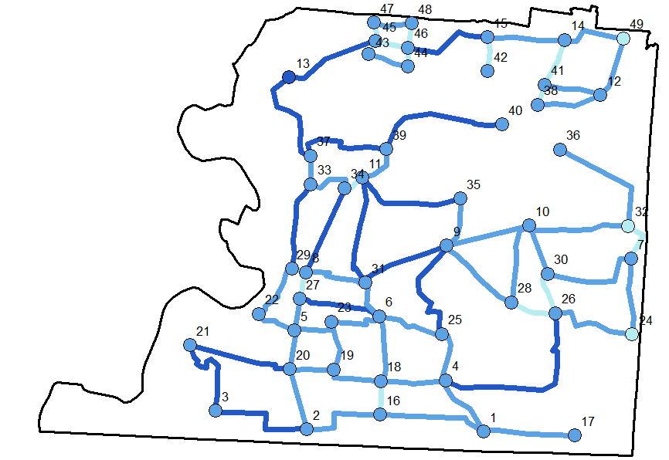

Slide 4
